Slide 1
HOUSING RECONSTRUCTION AWARAN PROJECT
presentation

Slide 2
SFD Grants
Project-I Construction of permanent Houses: Rs.260,000 per beneficiary in four installments Provision of Home Solar unit to each beneficiary | Total Approved cost :USD 25 Million
Project-II Construction of Government buildings | Total cost USD 1 Million
Project-III Restoration of Livelihoods at Awaran | Total Cost USD 1.5 Million

Slide 3
SFD Grant Housing Reconstruction Phase-II
Inauguration ceremony

Slide 4
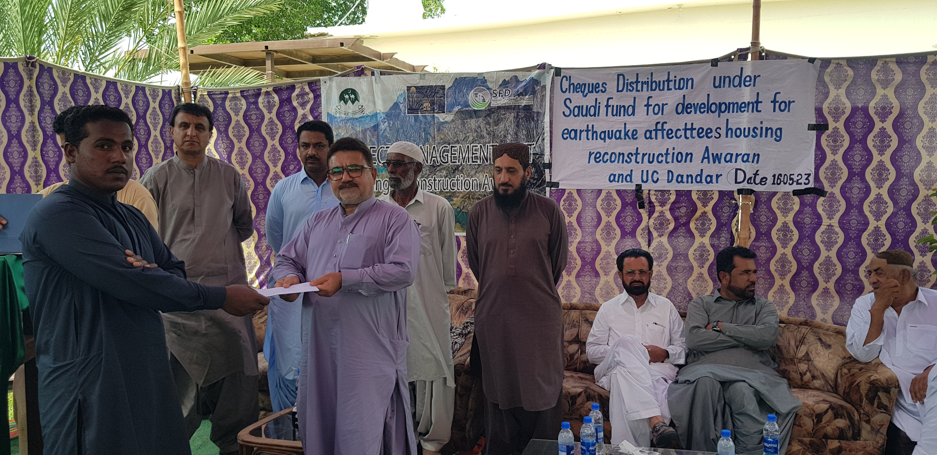
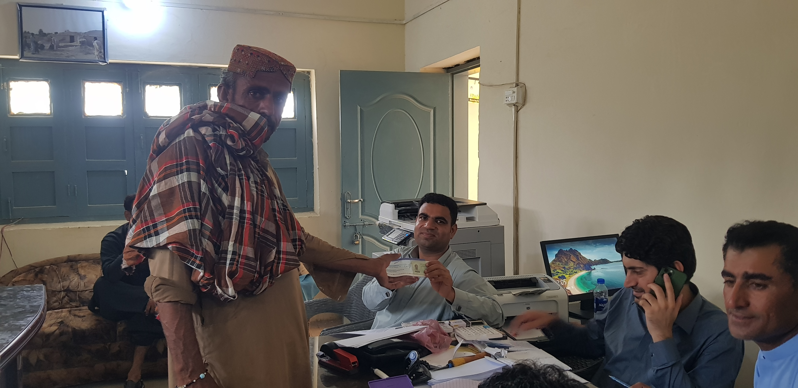
Cheque Distribution

Slide 5
SFD Grant Physical Progress
Level Wise Progress of the Project
1st Level advance for land-living | 7933
2nd Level achieved at Door band Level | 7361
3rd Level achieved at Roof band Level | 6549
4th Final Level & Completed Houses | 4219

Slide 6
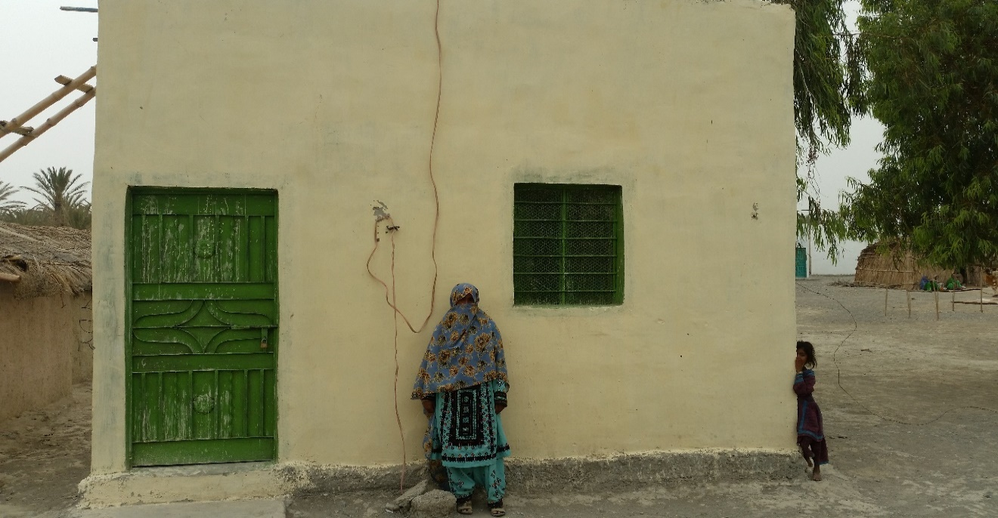
Completed Houses From SFD Grant

Slide 7
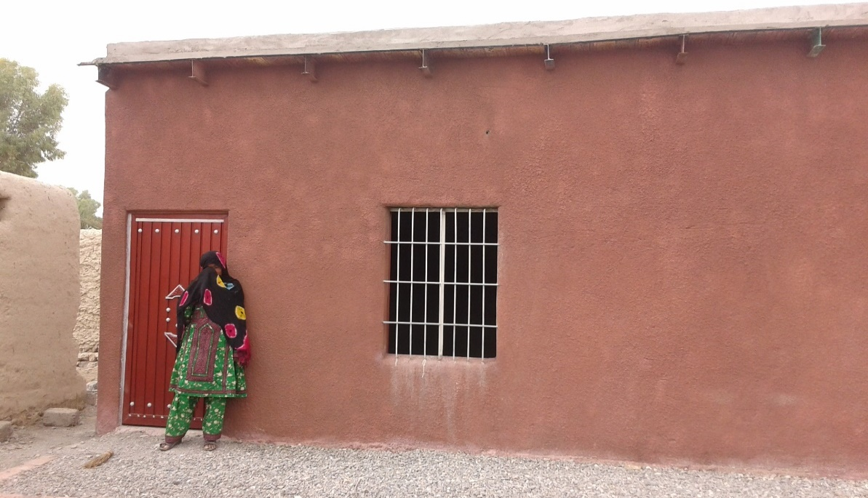
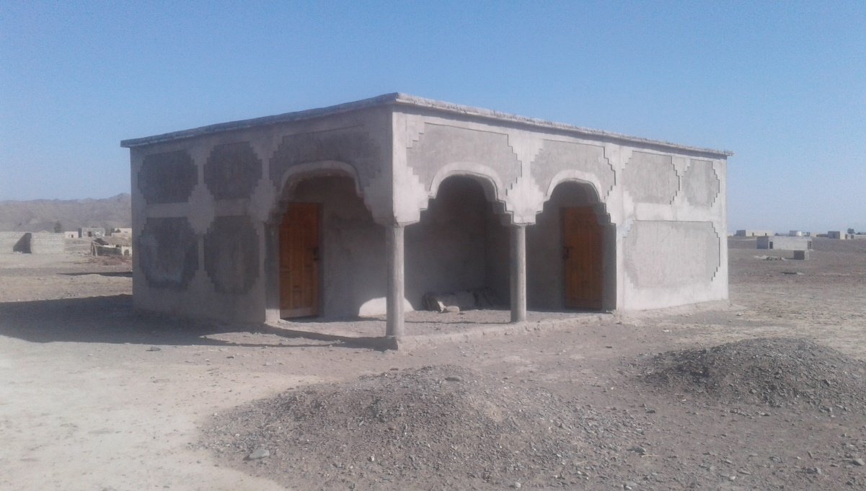
HRA Completed Houses

Slide 8
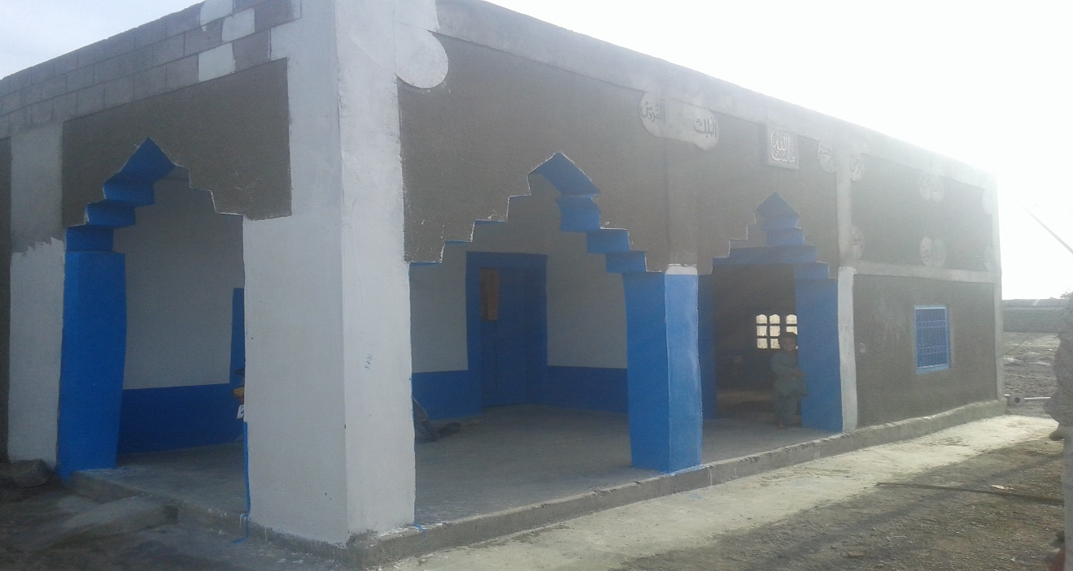
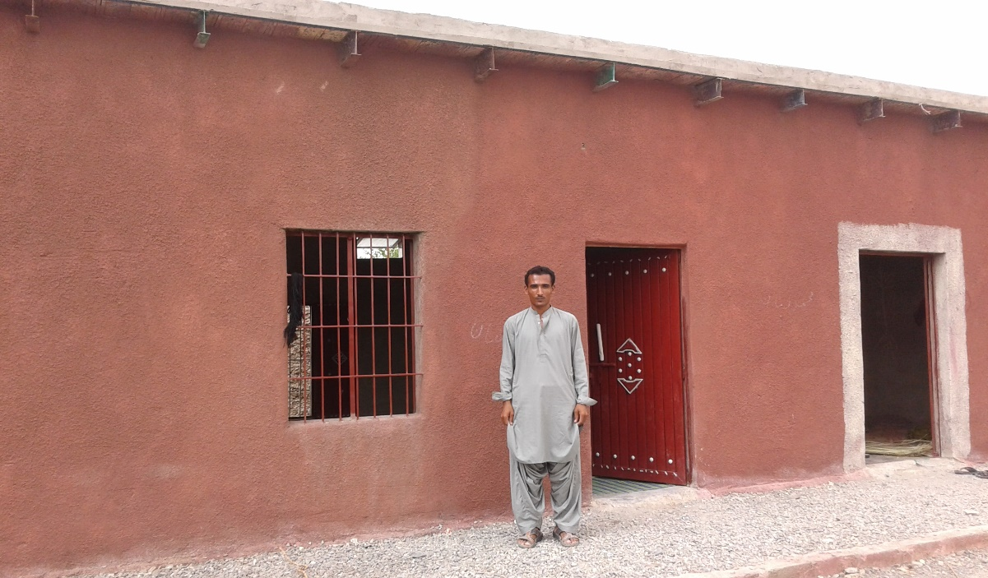
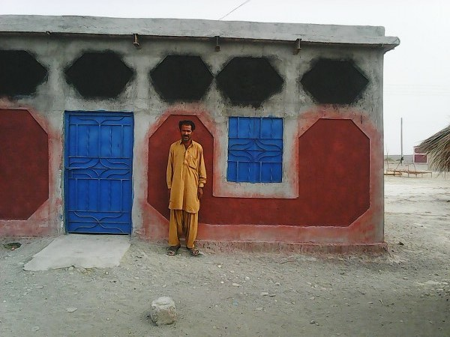
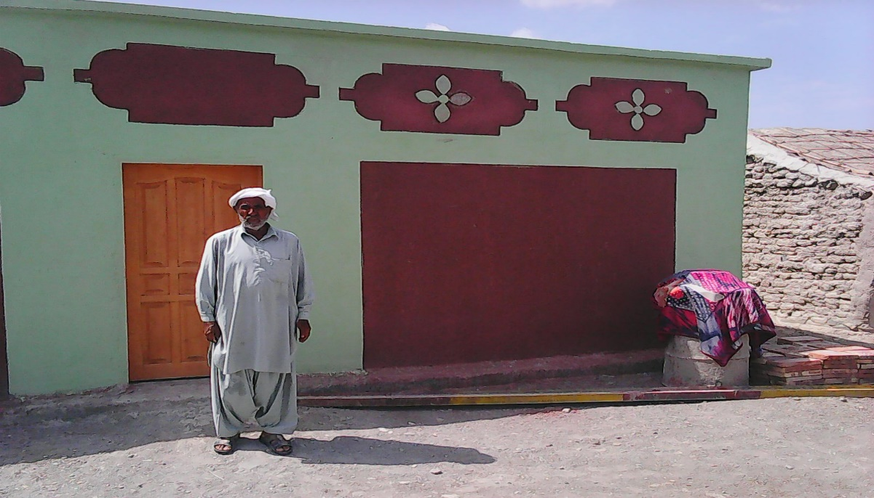
HRA Completed Houses

Slide 9
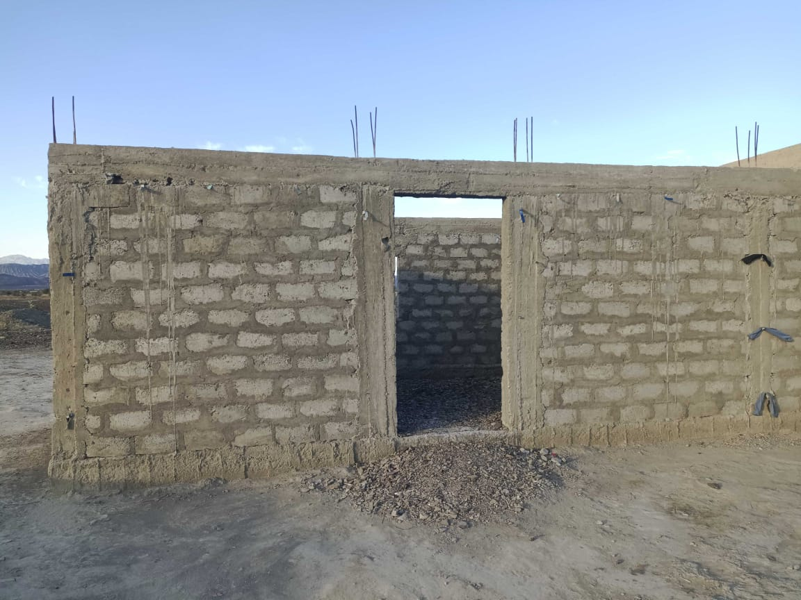
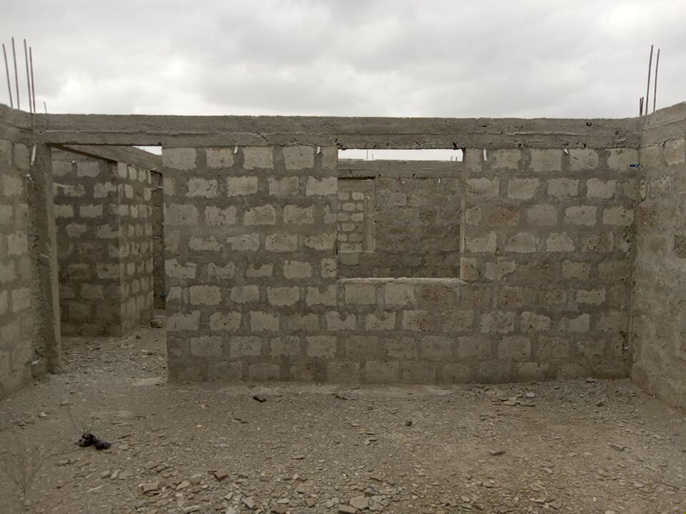
Door band 2nd level

Slide 10
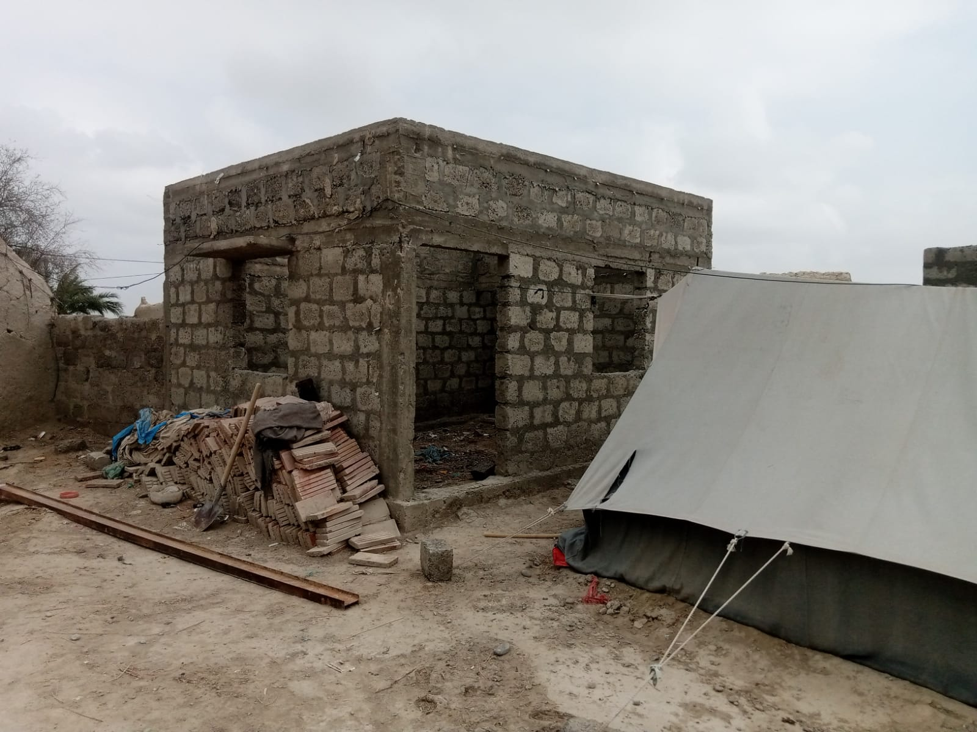
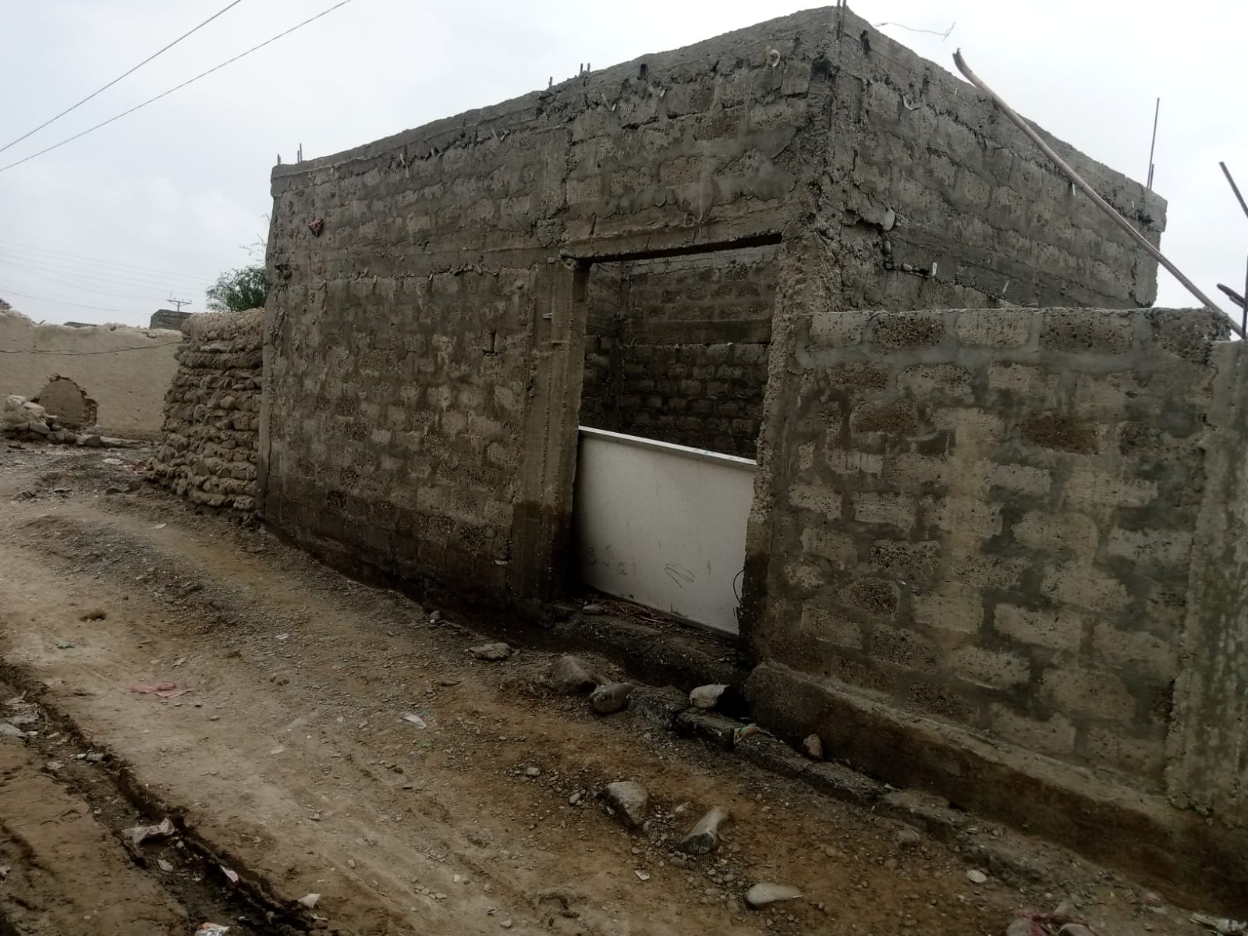
Roof band 3rd level

Slide 11
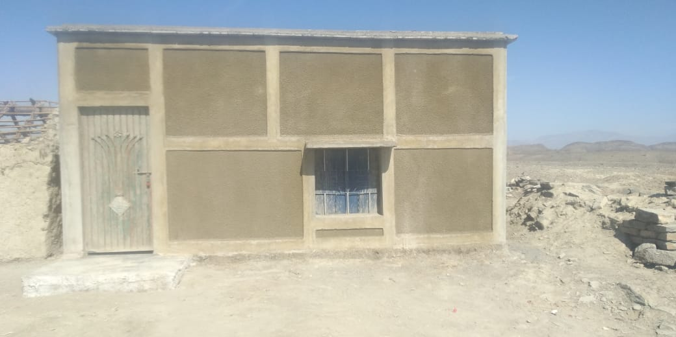
Completed 4th & final level

Slide 12
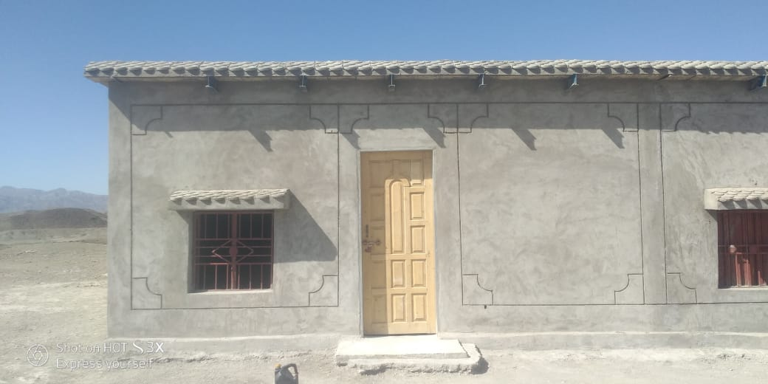
Completed 4th & final level

Slide 13
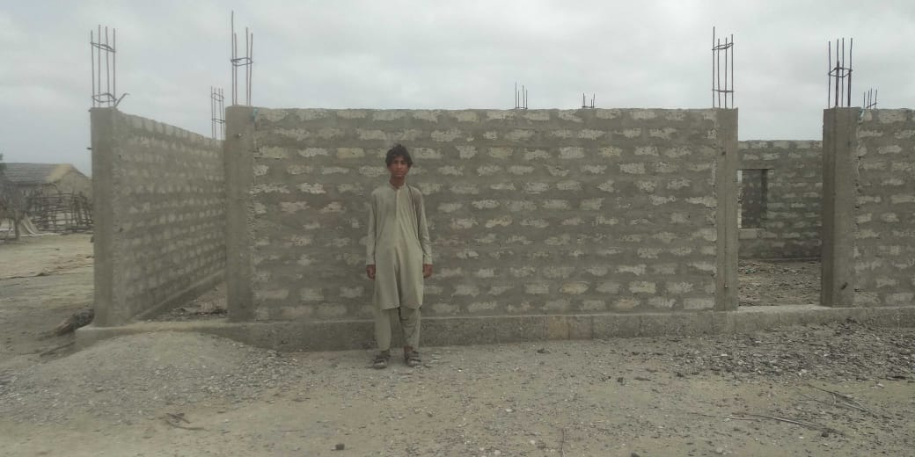

Slide 14
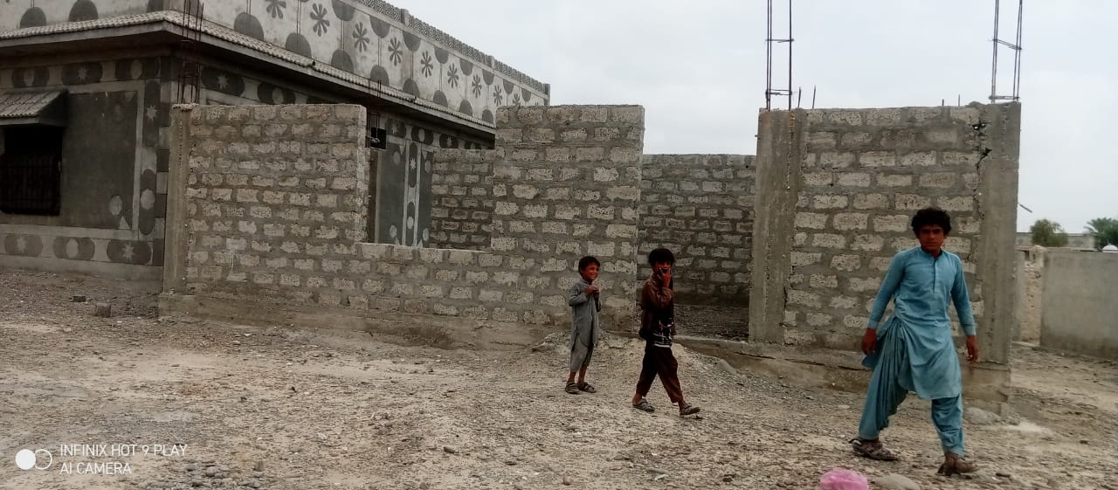

Slide 15
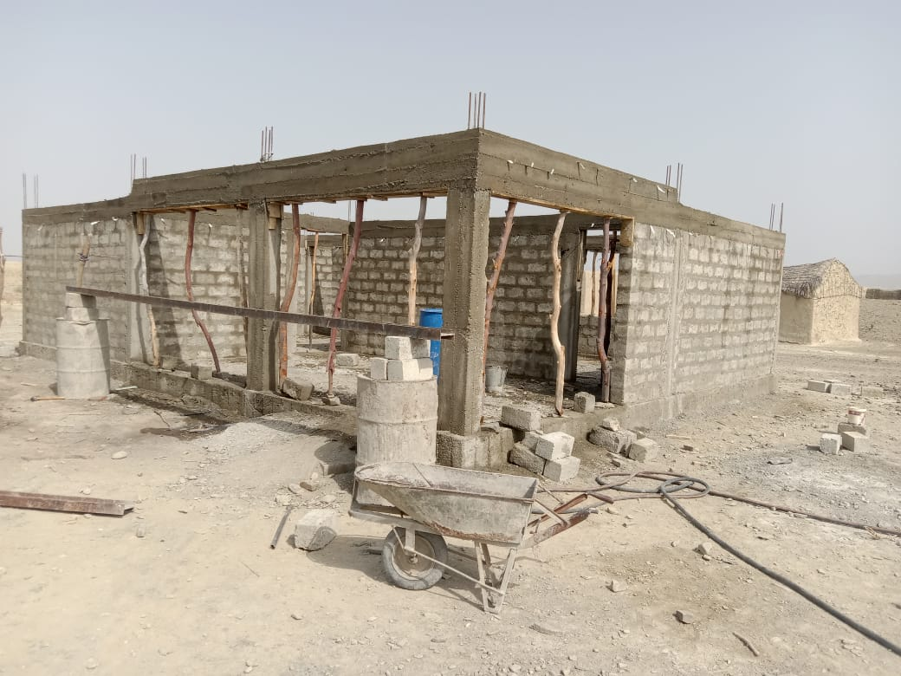

Slide 16
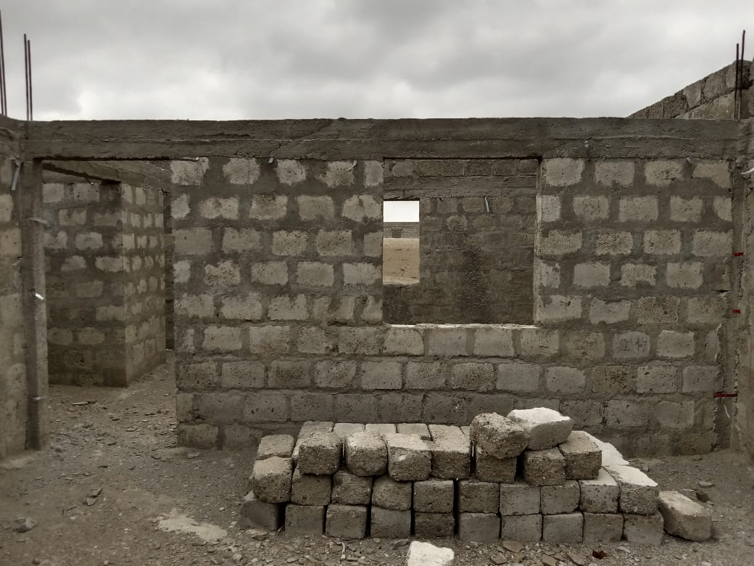

Slide 17
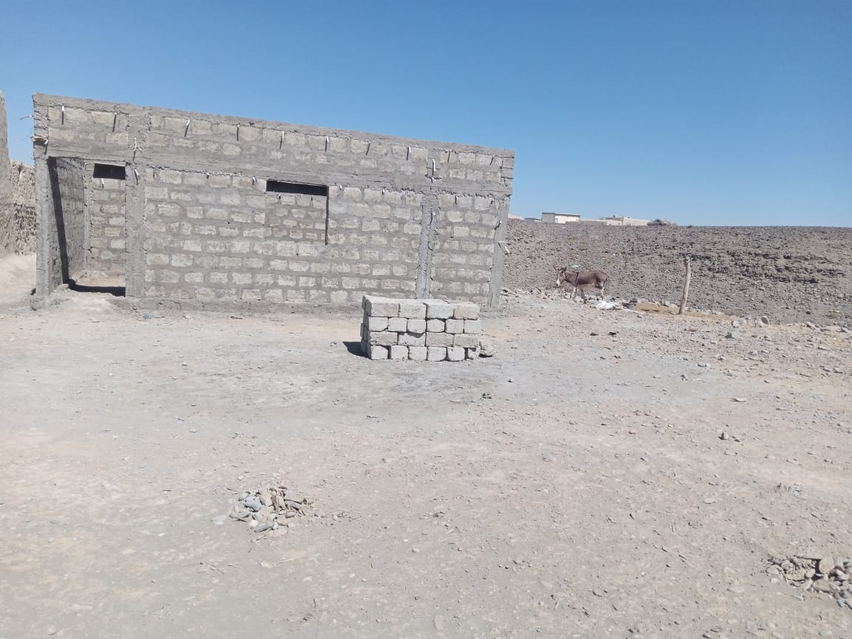

Slide 18
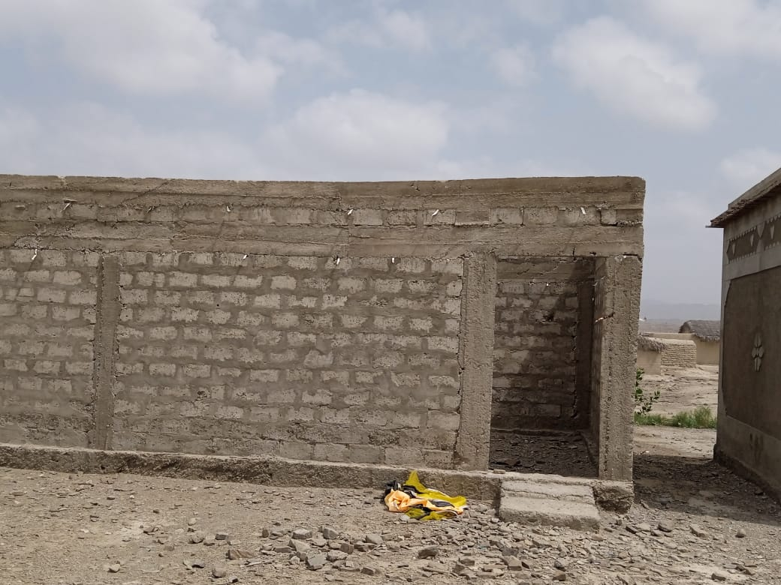

Slide 19
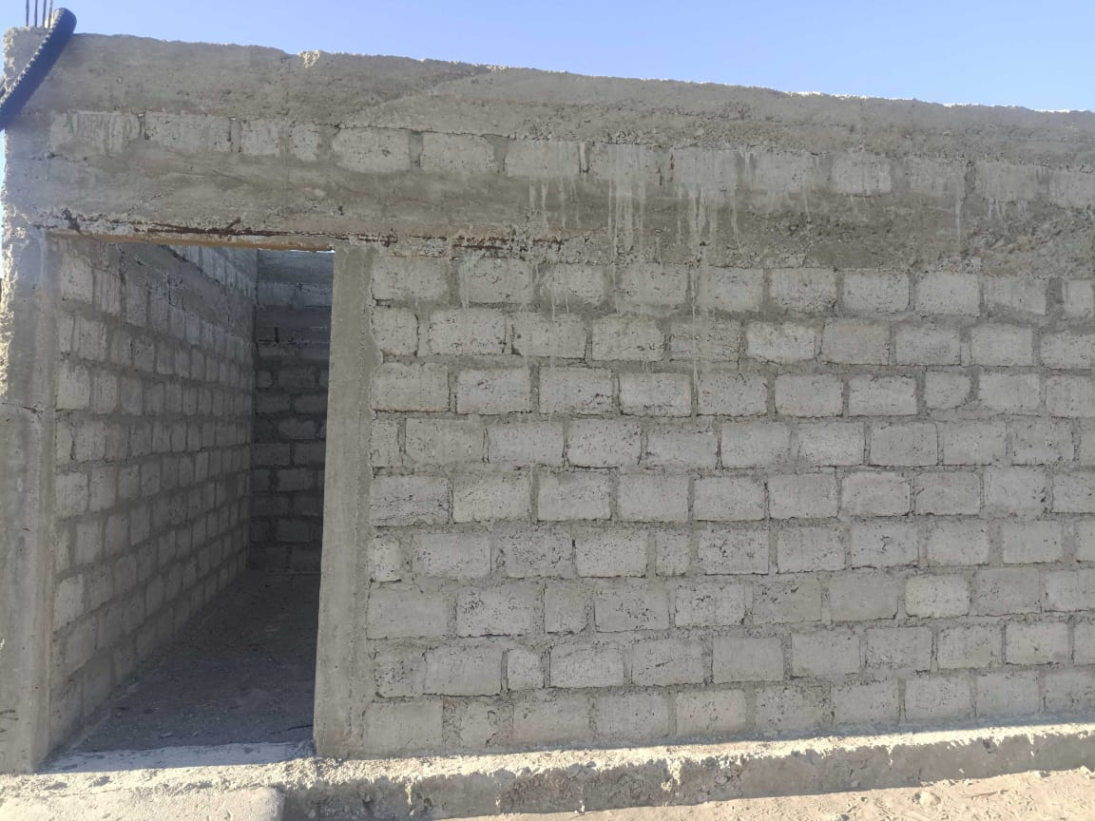

Slide 20
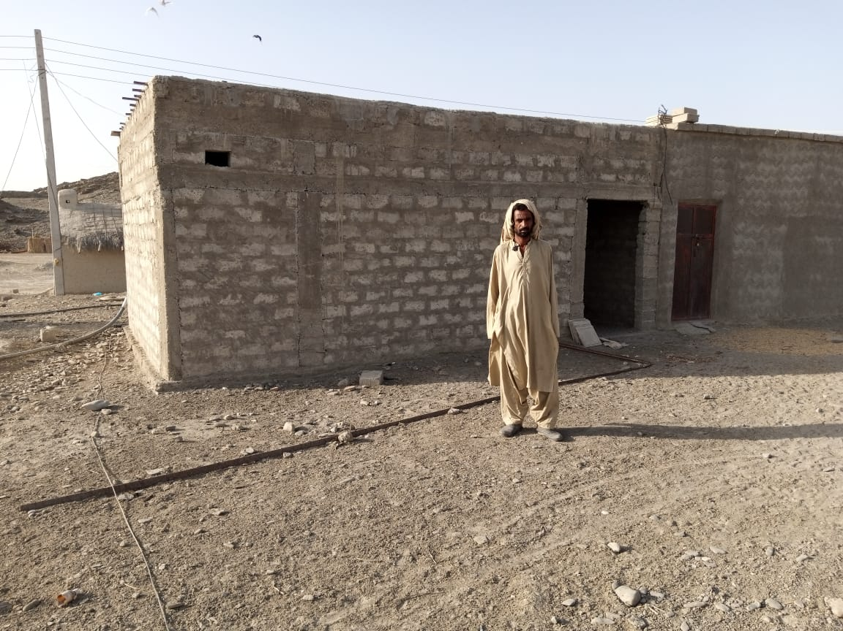

Slide 21
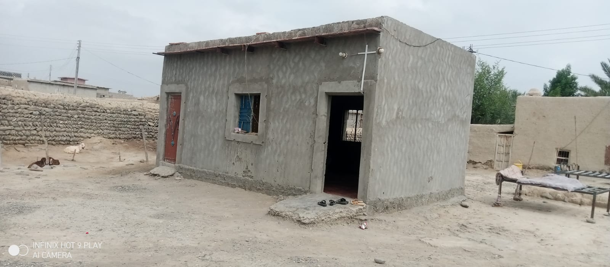

Slide 22
